Slide 1
AI on Google Could
Insight Intelligent Apps Guild

Slide 2

Jeff Cordes
Architect I – Apps and Infrastructure
Leader of Intelligent Apps Guild with Nick Fahrig and Frank Sikorski
Current Project: Multi-Cloud Chat (GCP + Azure) Paychex
My Leadership Philosophy
Empower – Focus on strong foundational growth by always empowering others to do more than they can today.
Innovation – Curiosity, setbacks, and Hunger should all be seen as analysts for innovation.
Be Fearless – Never let the fear of rejection or historic trends stop you from making a proposal or idea. Always present what you think is the best solution with clear communication and focus on a future outcome.
Be Fluid – Never let rigid processes stifle innovation, growth, or ideas. Existing processes must be fluid and update with the needs of teams, projects, and environments.
Empathy – Use empathy to focus on understanding people and not just their output, then use that perspective to continually grow the company in subtle but important ways.

Slide 3
Welcome to the Guilds!
Mobile Guild
Areas of focus: Native IOS, Native Android, Xamarin
Guild Leaders: Jason Daniels, Jeannette Mcelroy
Front-End Guild
Areas of focus: HTML/CSS/JS, Angular, React
Guild Leaders: Josh Tilling, Michael Lynch
Cloud Enablement Guild
Areas of focus: DevOps, Infrastructure, Automation, Cloud Governance, Security, Lift and Shift
Guild Leaders: Tony Lunt, Evan Brothers
Intelligent Apps Guild
Areas of focus: AR/VR, Bots, Cognitive Services, Artificial Intelligence, Machine Learning, IoT
Guild Leaders: Jeff Cordes, Frank Sikorski, Nick Fahrig
Modern Cloud Apps Guild
Areas of focus: Cloud-native apps, containers, serverless, PaaS, microservices, service mesh, integration/messaging, PowerApps, Power Automate, Java, Kotlin, .NET
Guild Leaders: Roger Bowman, Tom Dietrich, Robert Martin

Slide 4
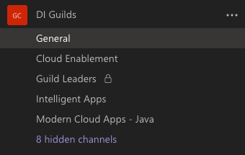
Reasons to Present for a Guild
Share your knowledge to help empower the rest of the practice.
Work on your presentation skills.
Show proficiency in a technical area or highlight a project you completed.
Make great deliverables for your goals in My Teammate Central.
Join our teams channel!

Slide 5
Democratizing AI

Slide 6

Our mission is to empower every enterprise to transform their business with AI
“
”
- Cloud AI Team

Slide 7
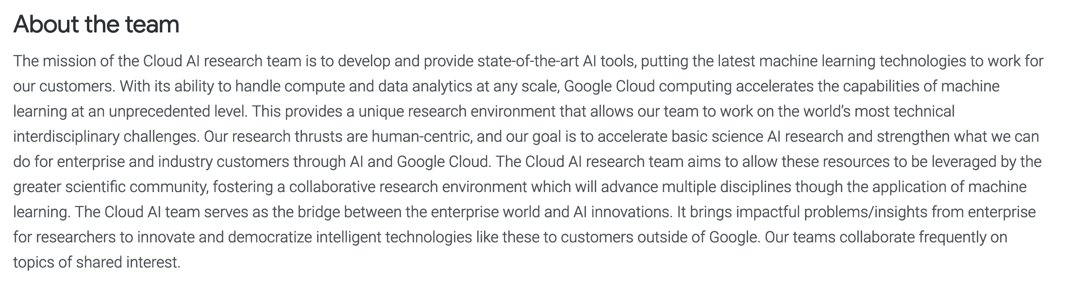

Slide 8
Google Cloud AI Infrastructure

Slide 9
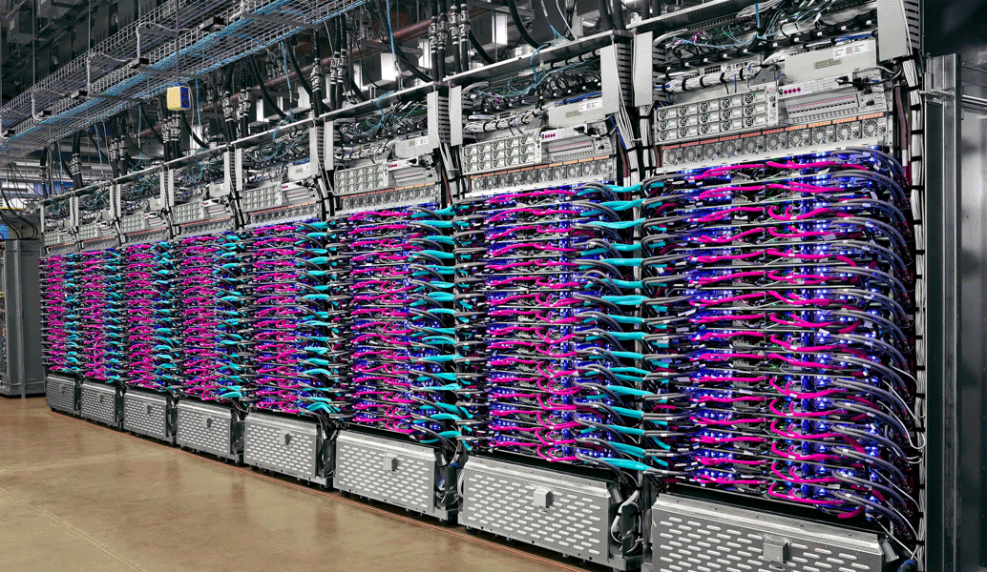
Powered By Tensor Processing Units (TPU)
We built the Tensor Processing Unit (TPU) in order to make it possible for anyone to achieve similar breakthroughs. Cloud TPU is the custom-designed machine learning ASIC that powers Google products like Translate, Photos, Search, Assistant, and Gmail.

Slide 10
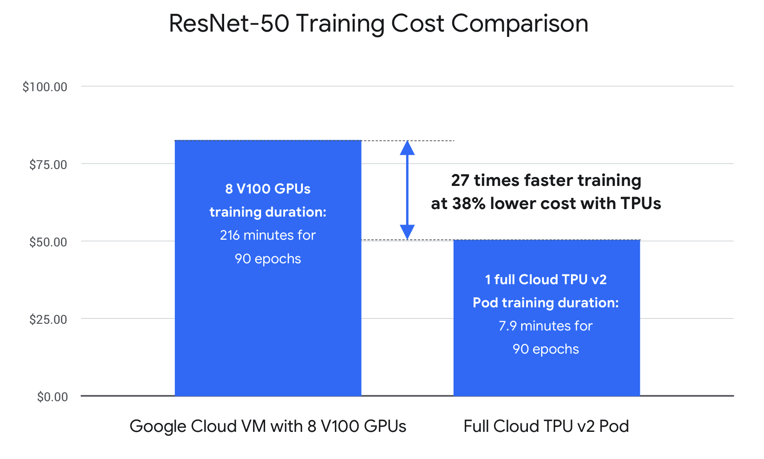
TPU Benchmarks
Notes:
a unit of computing speed equal to one million million (10¹²) floating-point operations per second.

Slide 11
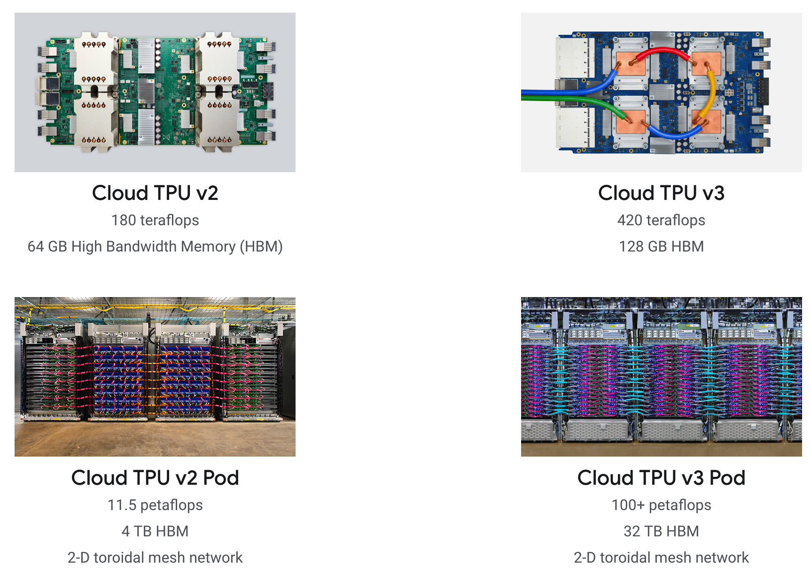
Cloud TPU Offerings
Notes:
a unit of computing speed equal to one million million (10¹²) floating-point operations per second.

Slide 12
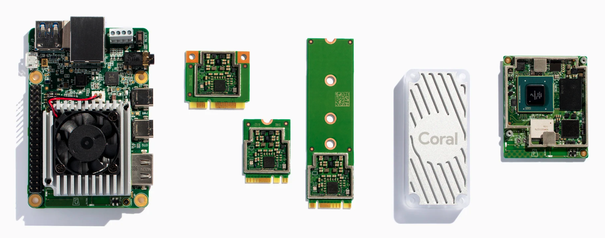
Edge TPU Offerings
Can Run Tensorflow Light and AutoML models on the edge.

Slide 13
Google Cloud AI Tools

Slide 14












Google Cloud AI Tools
Developer Tools
Data Scientist Tools
AI Platform
Tensorflow
AI Building Blocks
Auto ML

Slide 15
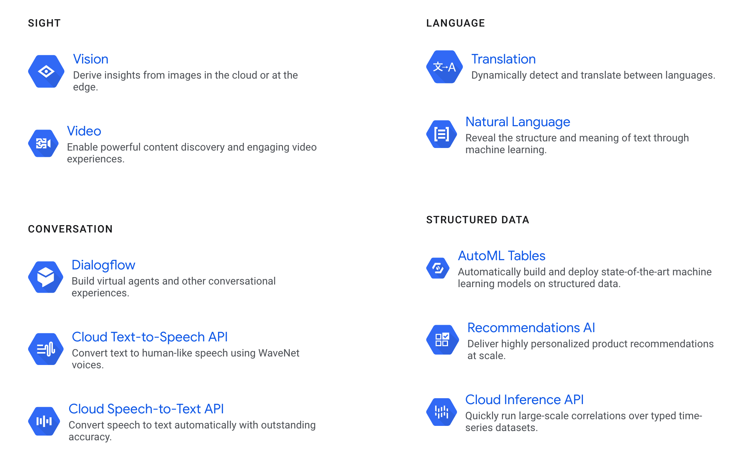

Slide 16
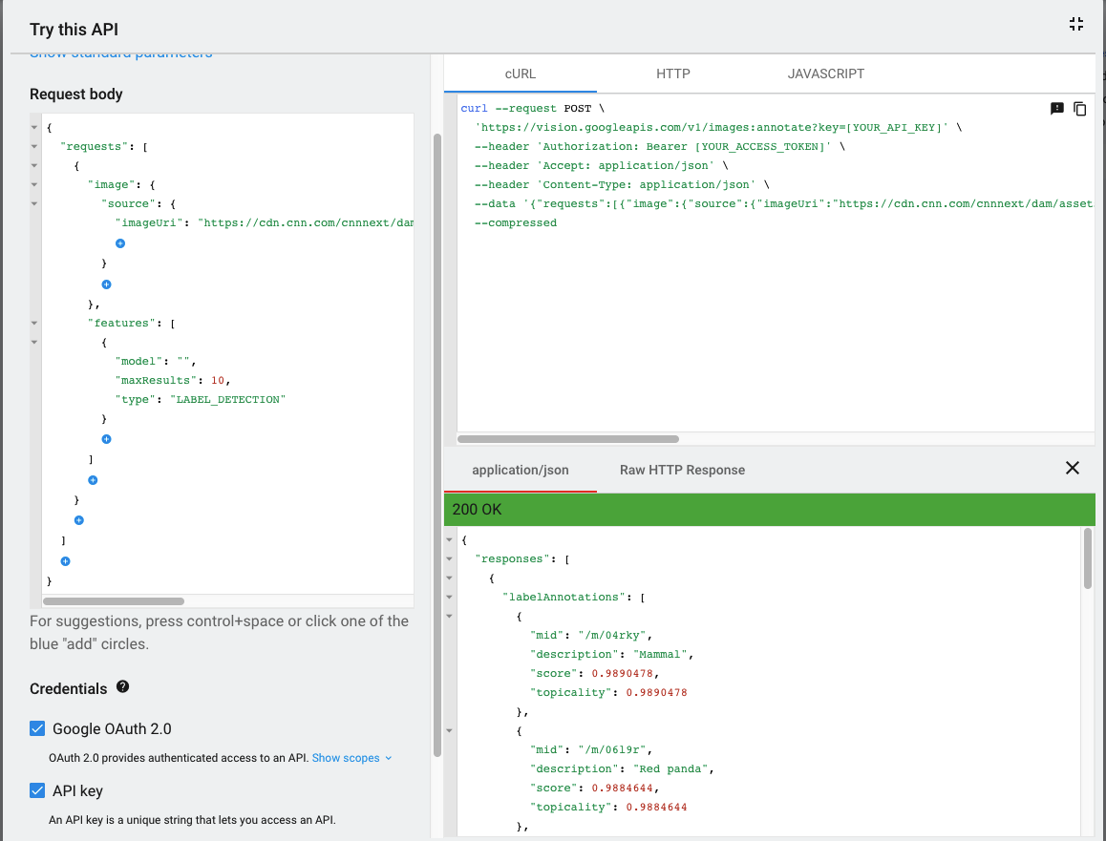
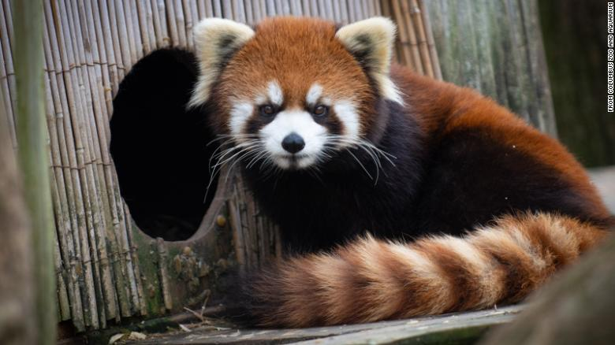
Vision API Example

Slide 17
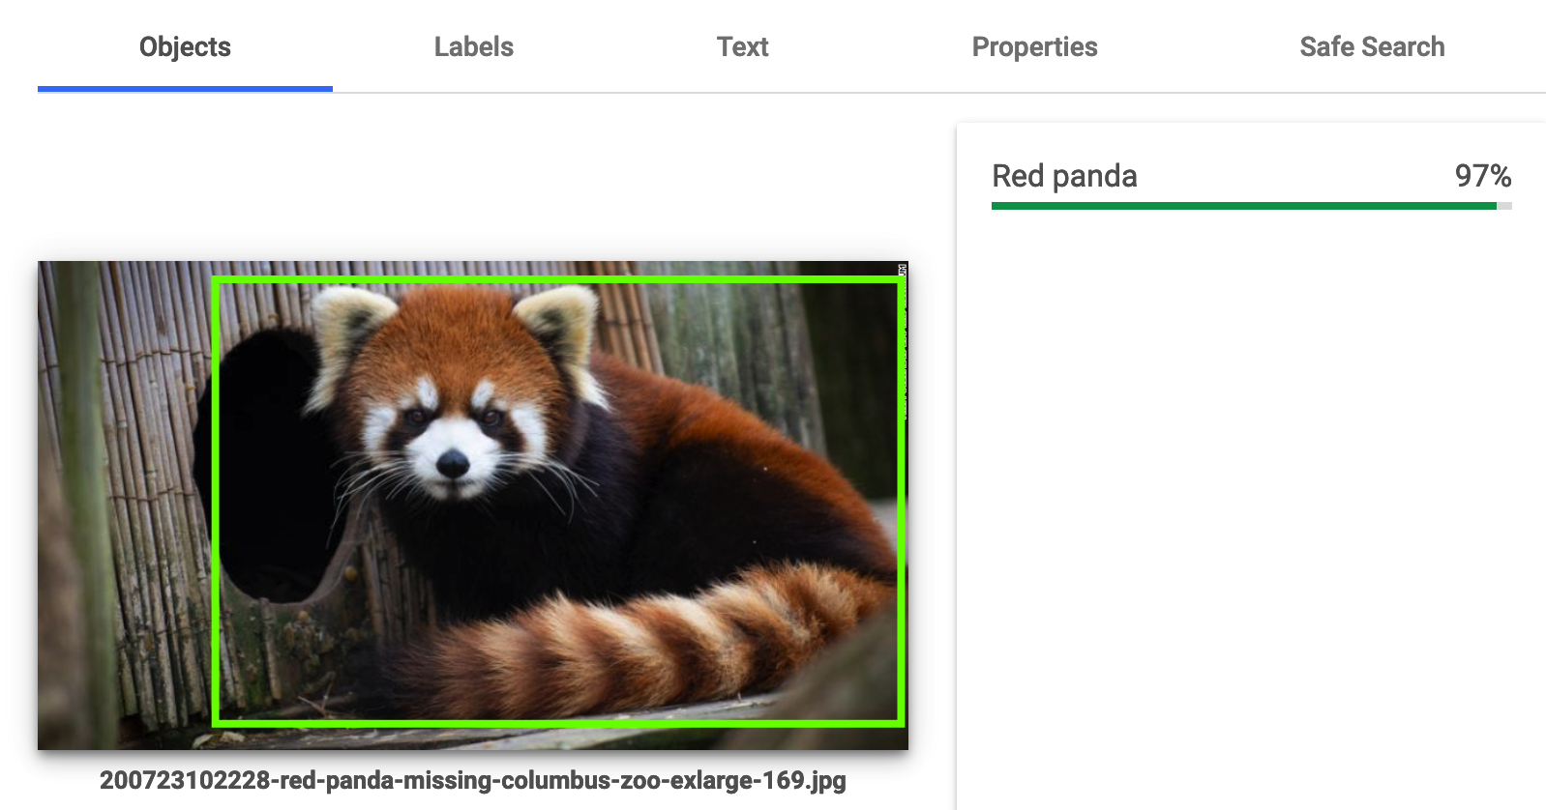
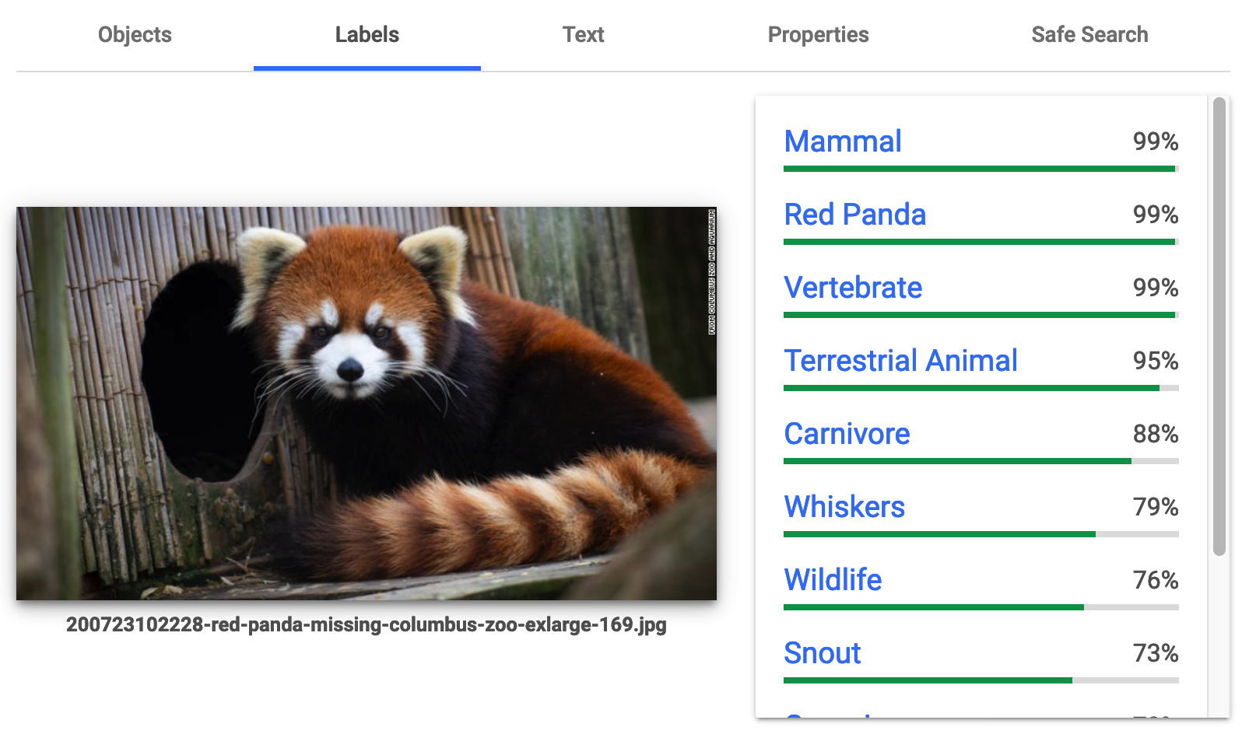
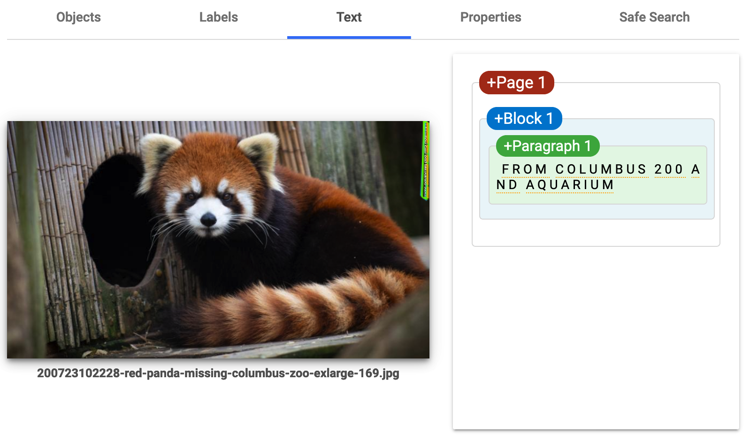
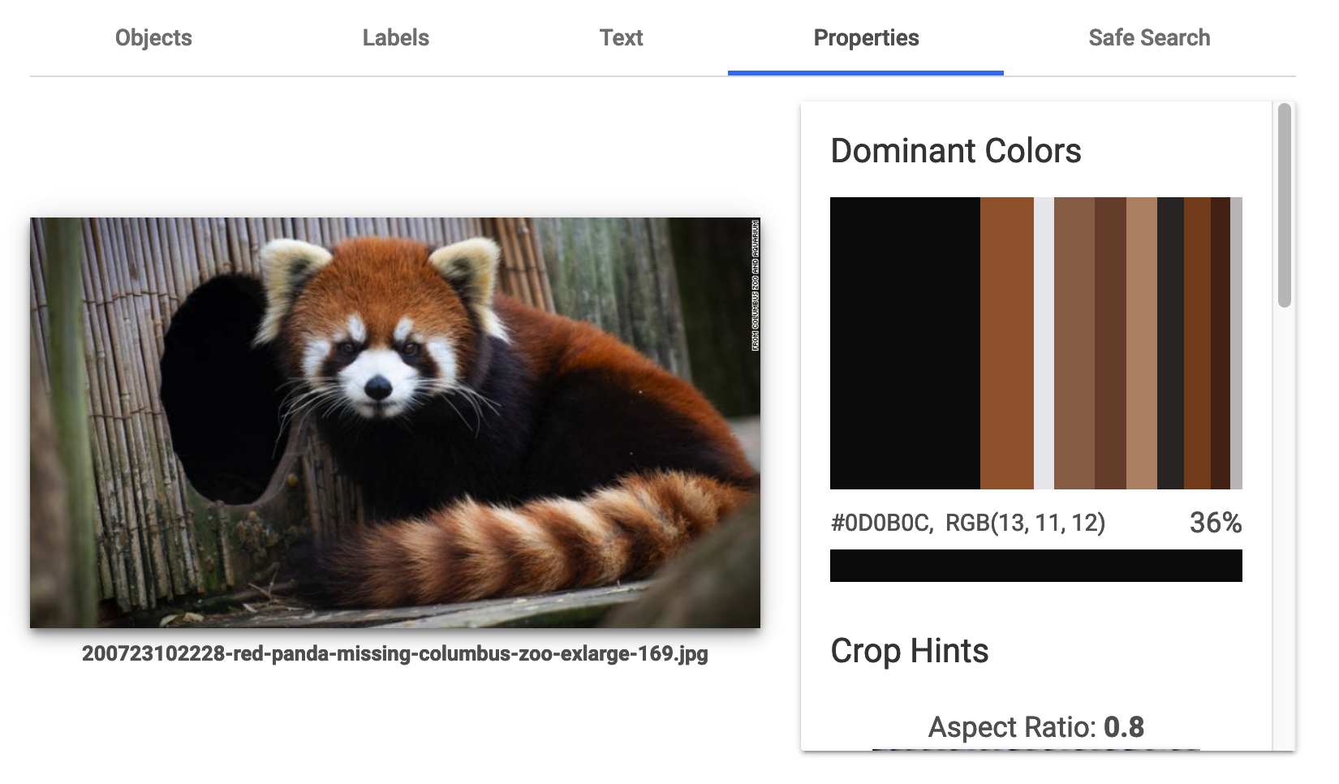
Vision API Results

Slide 18
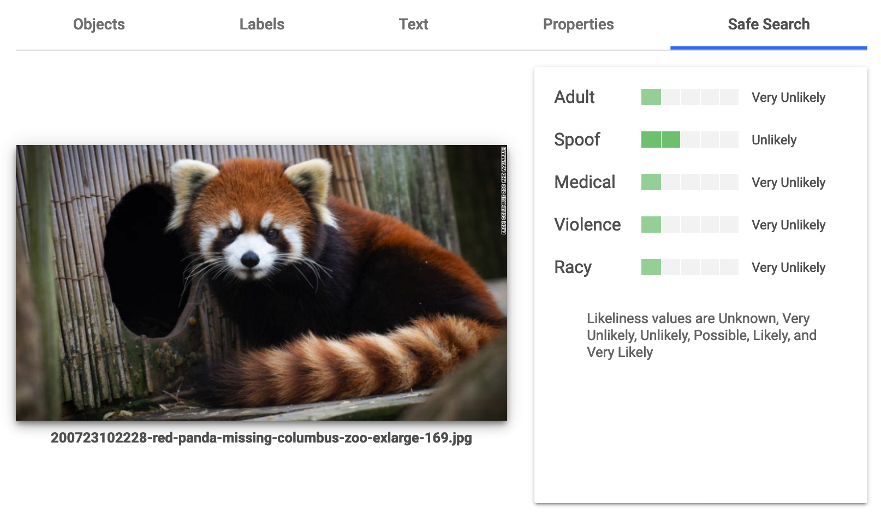

Slide 19

Video Features
Labels (pre-trained only)
Shot Change Detection
Object detection and tracking
Text detection and OCR
Explicit content
Automated Closed Captions (transcribe)
Logo Recognition
Celebrity Recognition (limited access)
Face Detection
Person + pose (Beta)

Slide 20
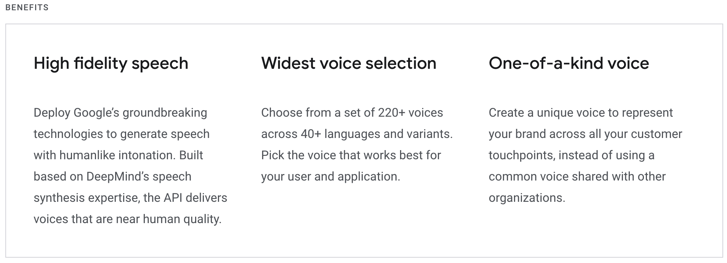
Conversation – Text to Speech
https://cloud.google.com/text-to-speech

Slide 21
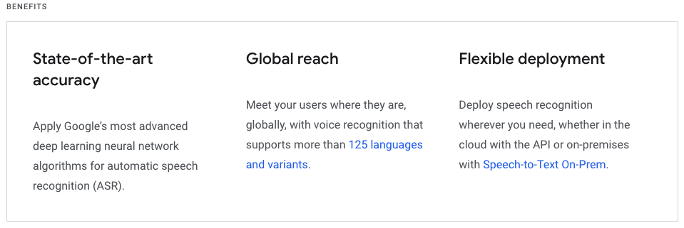
Conversation – Speech to Text

Slide 22
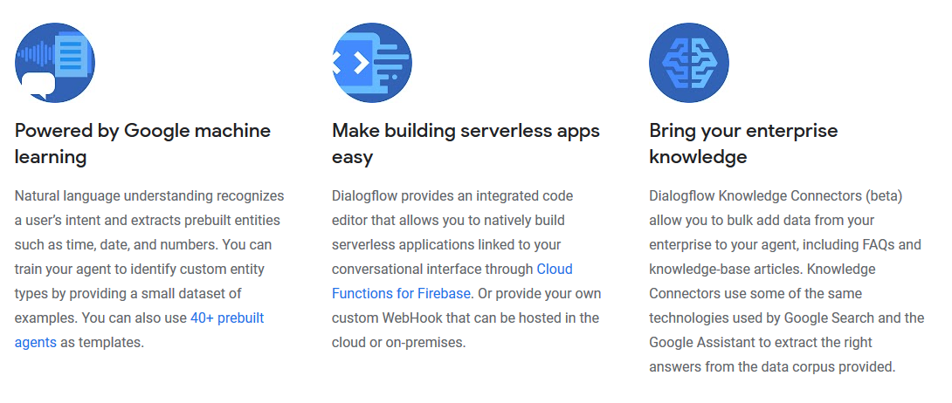
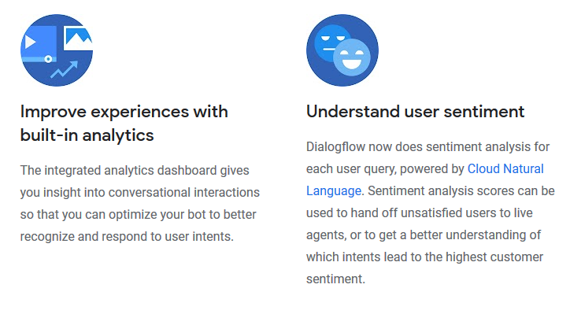
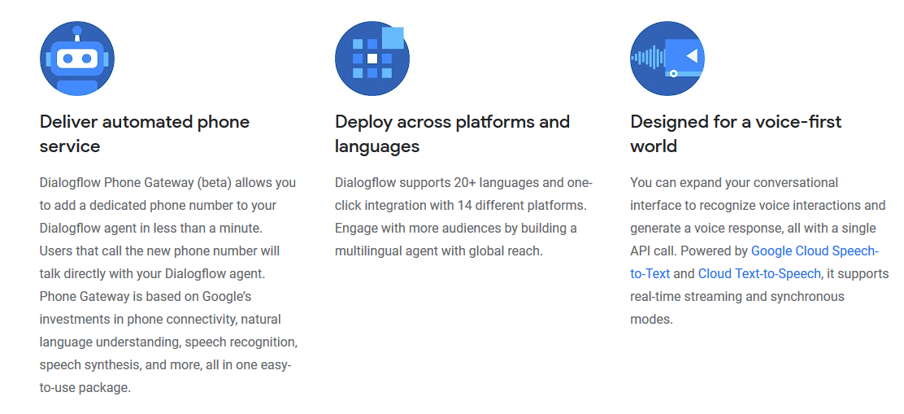
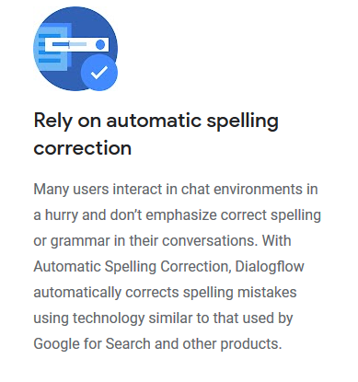
Conversation - Dialogflow

Slide 23
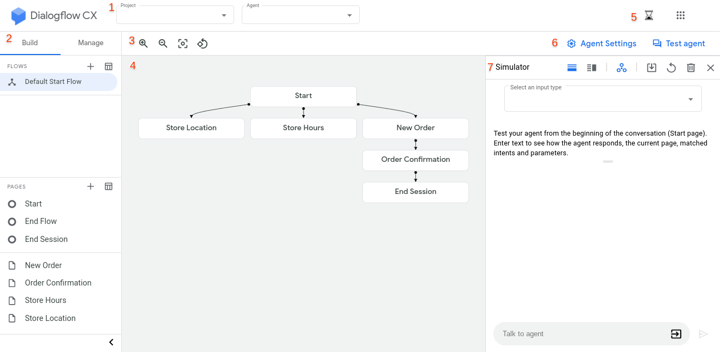
Conversation – Dialogflow CX (Beta)

Slide 24
Language - Translation
Over 50 languages
Language Detection
Translation
Glossary support (brand related content)

Slide 25
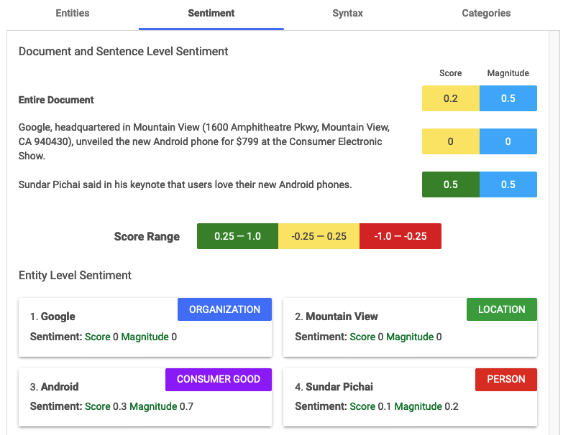
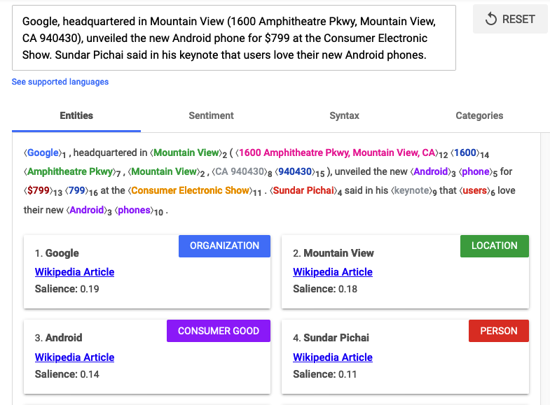
Language - Natural Language

Slide 26
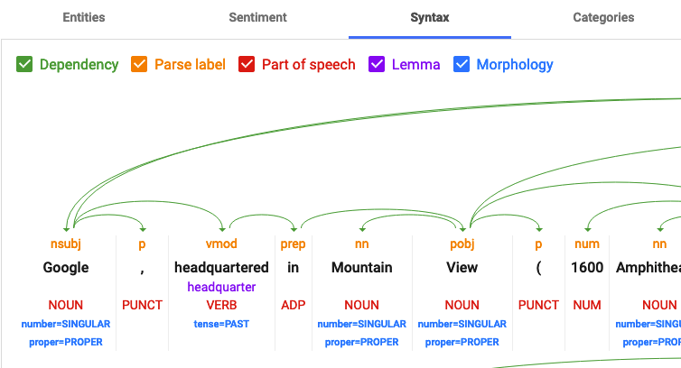
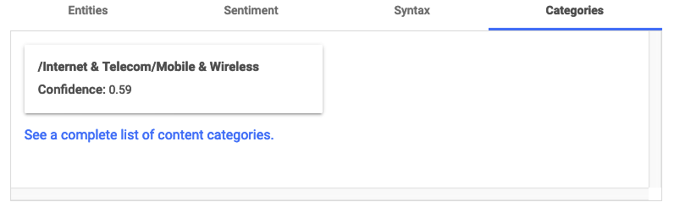
Language – Natural Language

Slide 27
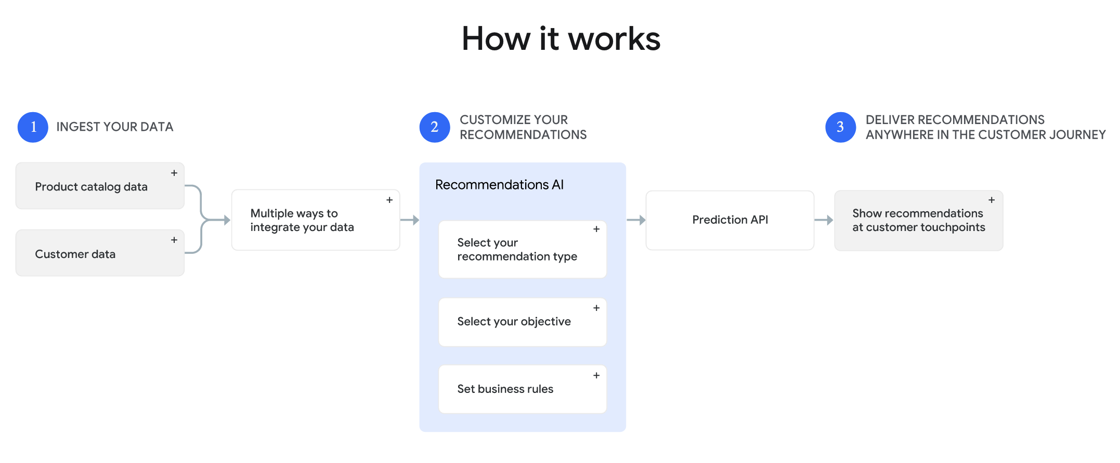
Data - Recommendations

Slide 28
Demo
Setup initial project and IAM in GCP
Jupyter notebooks to use Vision and video inference through python SDK And REST
Github: https://github.com/JeffCordes/GoogleCloudAI

Slide 29
Auto ML
Create your own custom machine learning models with an easy-to-use graphical interface.

Slide 30
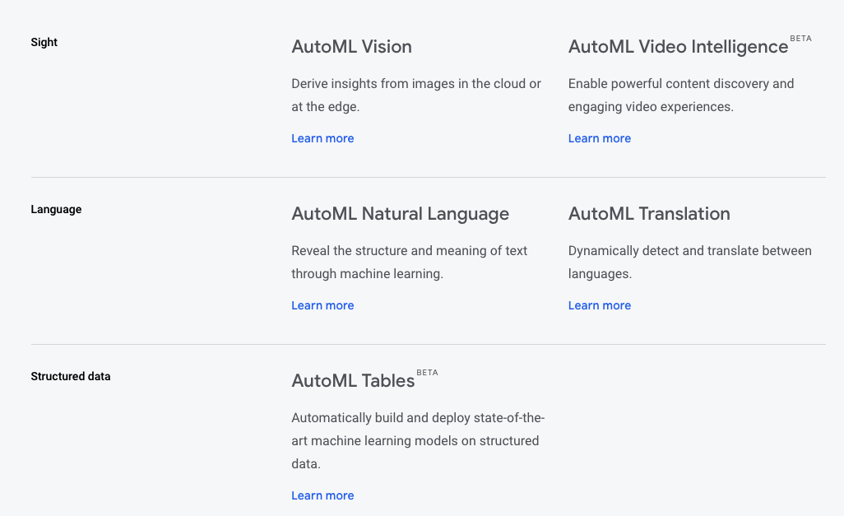

Slide 31
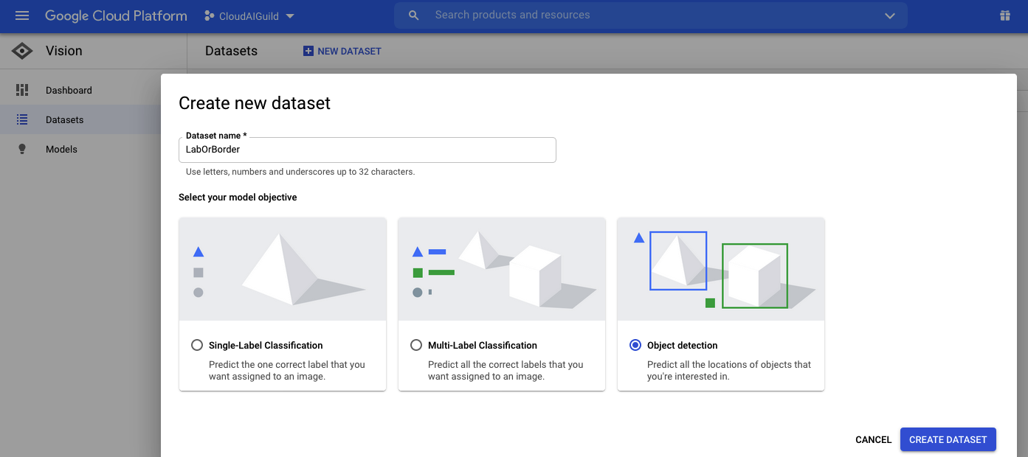
User Interface For Dataset Creation

Slide 32
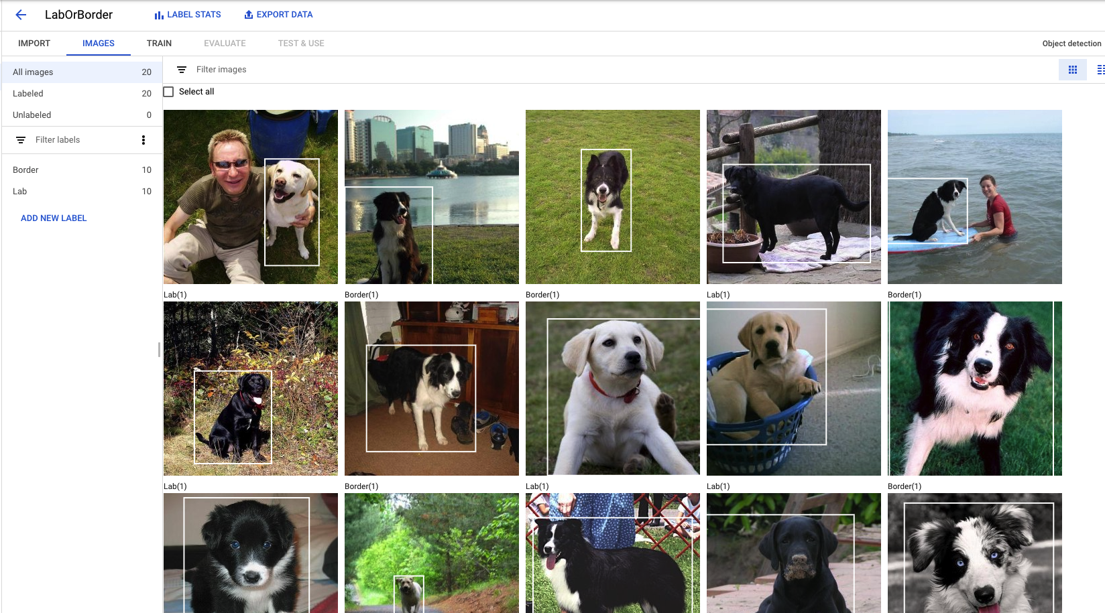
User Interface For Dataset Creation

Slide 33
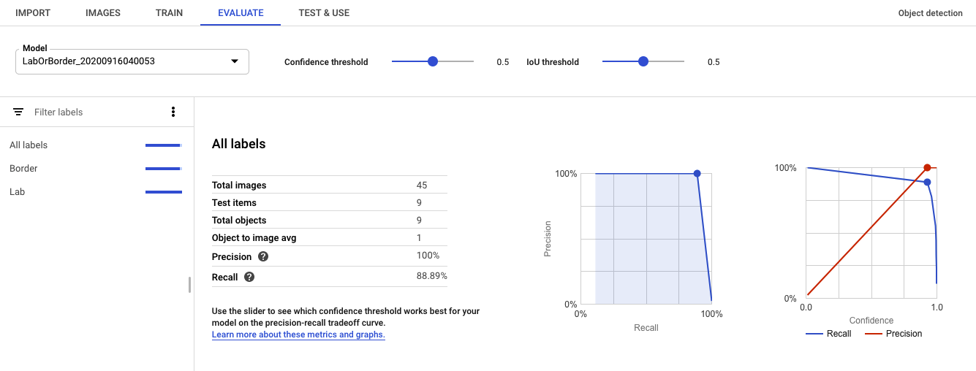
Train and Evaluate

Slide 34
Image classification training costs
The cost for AutoML Vision Image Classification model training is $3.15 per node hour.
For each unit of time, we use 8 nodes in parallel, where each node is equivalent to a n1-standard-8 machine with an attached NVIDIA® Tesla® V100 GPU. See Table below*.
The time required to train your model depends on the size and complexity of your training data. Many customer find that 8 node hours (approximately 1 "wall clock" hour) is sufficient to build an experimental model. Additional training time increases accuracy to a production level. The early stopping feature ensures that training stops when further accuracy improvement is not possible.
You pay only for the compute hours used; if training fails for any reason other than a user-initiated cancellation, you will not be billed for the time. You will be charged for training time if you cancel the operation.
Training example
Example 1 - Cloud model with resumable training
You trained a Cloud Image Classification model for experimental use with 40 node hours, and two days later spent 16 node hours of resumable training to get it ready for production use.
You will receive a bill that shows:
($3.15 per node hour) * (40 node hours) = $126.00 for the initial training
($3.15 per node hour) * (16 node hours) = $50.40 for the resumable training

Slide 35
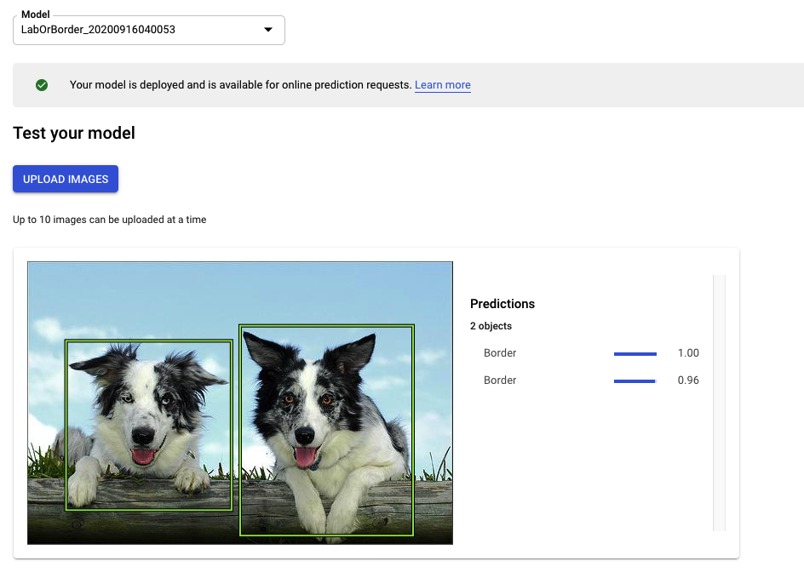
Inference on trained model

Slide 36
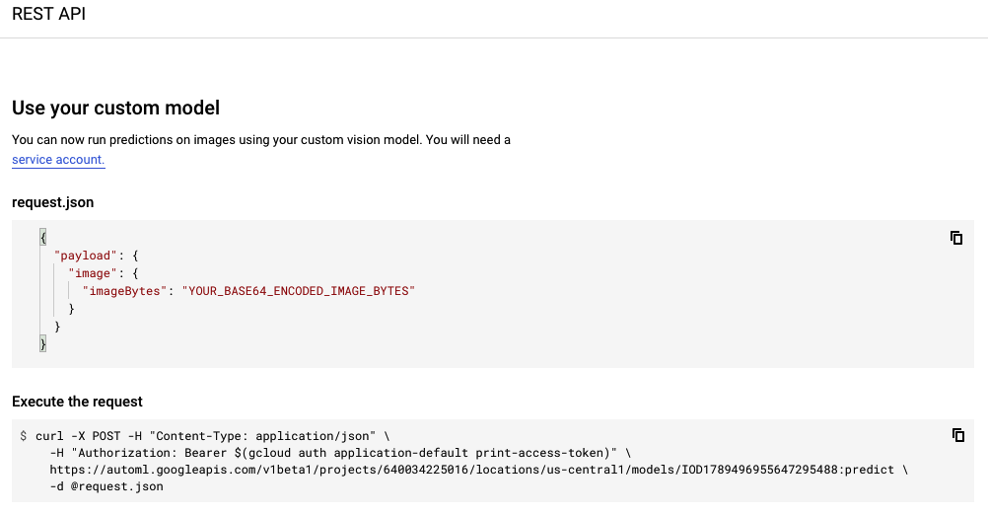
Code examples of model use

Slide 37
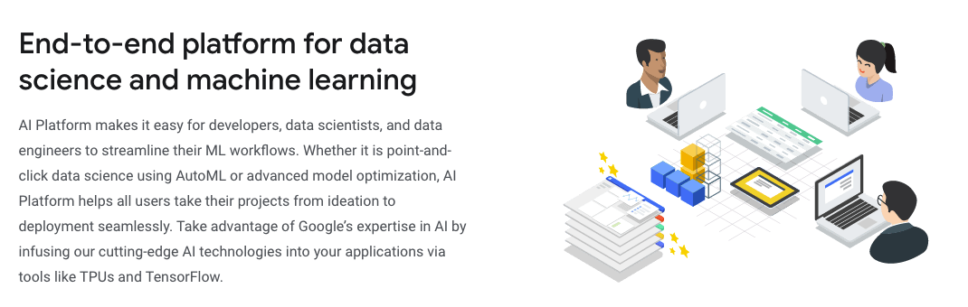
AI Platform

Slide 38
AI Platform Services
Prepare
BigQuery DataSets
Data Labeling Service
Build
AutoML
AI platform notebooks
AI platform training
Validate
Explainable AI
AI Platform Vizer
Deploy
AI platform prediction
AutoML Edge
Tensorflow Enterprise
ML Ops
AI Platform pipelines
Continuious evaluation
Deep Learning VM
Deep Learning Containers

Slide 39
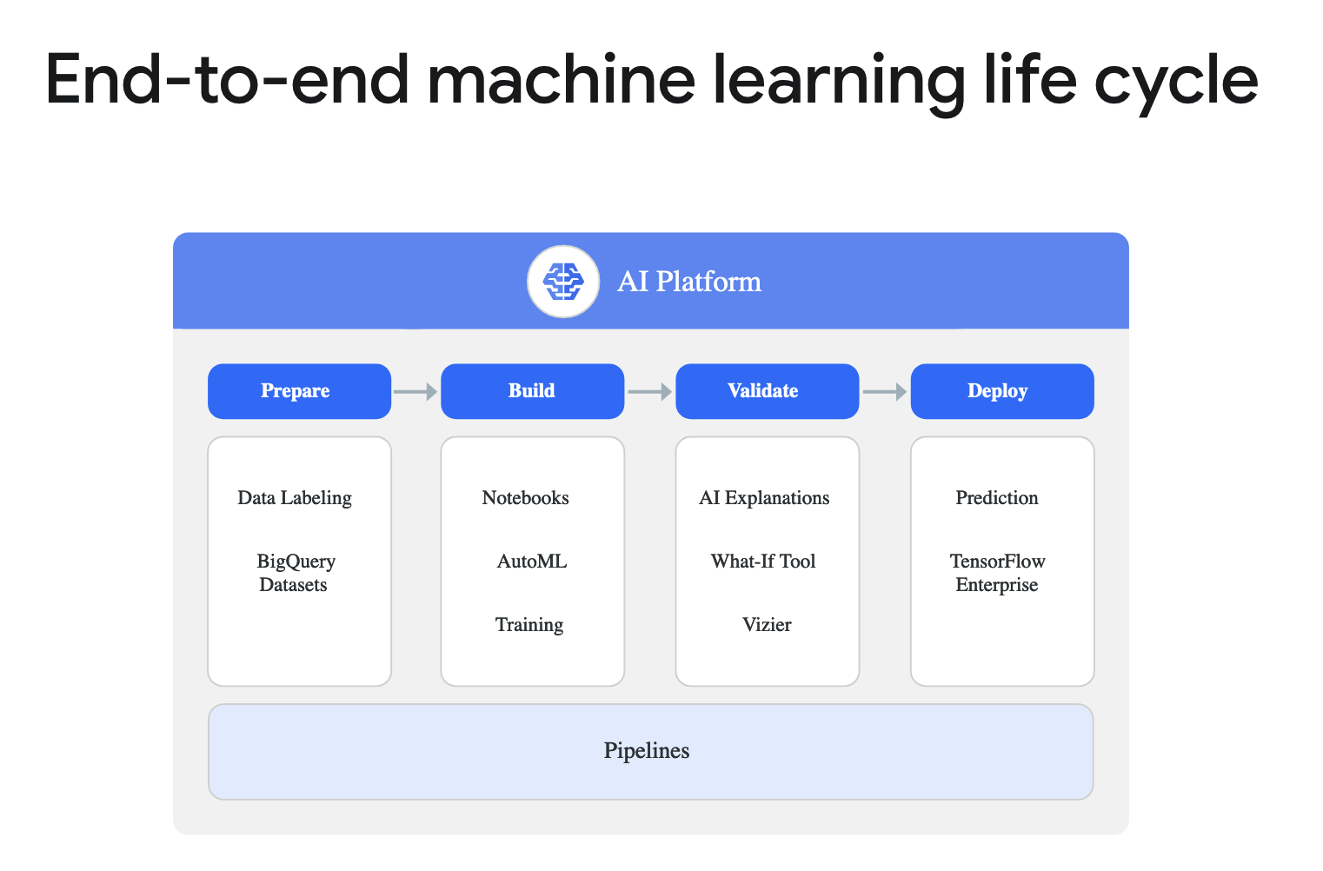

Slide 40
Questions

Slide 41
Reasons to Present for a Guild
Share your knowledge to help empower the rest of the practice.
Work on your presentation skills.
Show proficiency in a technical area or highlight a project you completed.
Make great deliverables for your goals in My Teammate Central.
Join our teams channel!

